Slide 1


Got Score?
Don Almeida,
Manager, DevOps CoE
Rajat Sud
Principal Engineer, DevOps CoE
Scaling DevOps Adoption
Service Benefit Plan Administrative Services Corporation, an affiliate of CareFirst, Inc.

Slide 2
Who we are and what we do
Service Benefit Plan Administrative Services Corporation (SBPASC):
5.5 Million Members | Seamless Delivery | Over 1,300 individuals
Technology solutions for a national health plan with over 5.5 million members globally | Seamless delivery of claims, enrollment and customer service capabilities, and delivery of data and analytics that enable critical business decisions | Headquartered in the Washington D.C. metro area, the SBPASC team includes over 1,300 individuals dedicated to transforming healthcare technology in service of our customers’ goals for improved member experience and health outcomes

Slide 3
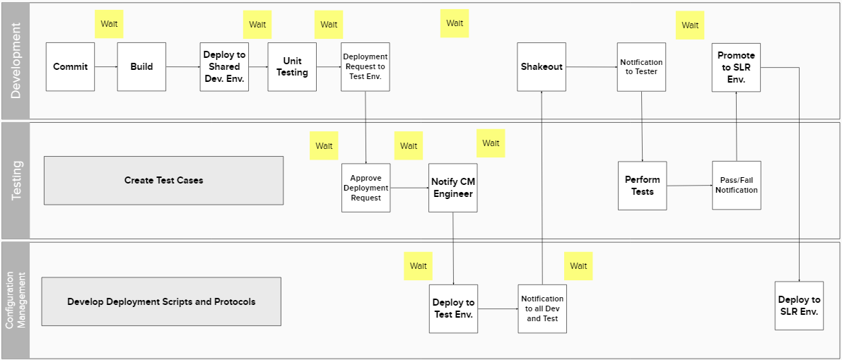
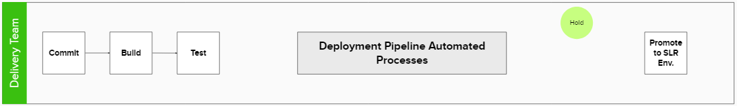
Our Software Delivery Value Stream (and the opportunities it presents…)

Slide 4
Goals achieved through Focus Areas
Goals
Focus Areas
Deliver features to our customers faster
Consistent and Repeatable Practices
Achieved through…
Optimized and Predictable Flow
Reduce wait times so teams can focus more on creating customer value.
Improved Feedback Loops, Fast Detection, Recovery
Prevent unnecessary rework, by automating tasks that are currently done manually.
Continuous Learning and Experimentation

Slide 5
Our Empowerment Engagement Model
The DevOps Center of Excellence
Platform Engineering
Guaranteed uptime
Training Guides
DevOps Playbook
Onboarding
Rapid scaling for new applications using existing technologies
Collaborative design for new, emerging technologies and initiatives
Adoption
Dedicated champions working alongside the delivery teams
Recognizing data-driven opportunities and implementing new initiatives

Slide 6
(Some) (data-driven) DevOps Initiatives
Pipeline Stability
Pipeline Gaps
Reducing wait times
Improved Development Practices
Code Quality
Remediating failed quality gates
Improving Code Coverage
… & more…

Slide 7
(Near) Real Time Insights
Probing our tools (in addition to humans) for pain points and opportunities
The usage of our DevOps tools tell a story
Elicit this story to identify insights
Present these insights into opportunities for improvement
Finally, wrap these opportunities into initiatives to gamify adoption

Slide 8
(Near) Real Time Insights
We’re not unicorns, we’re thoroughbreds!
Bottom-up: Incentives, events, adoption drives, community, fun!
In the middle: CoE facilitates (data-driven) enablement
Top-down: Alignment and bake into performance plans
Instigating a culture shift
Actionable, just-in-time/just-enough insights
Clear-cut direction, while also providing forums for thought leadership

Slide 9
Got Score?
An objectified, aggregated numeric representation (“score”) of DevOps data extracted from the usage of our platform associated with every deployable unit
View this aggregation to determine opportunities for improvement
Leadership reviews these “scores” rolled up at the team-level and/or at the LoB level
…Let the games begin!

Slide 10
Got Score? – The Methodology
Capability (for the deployable unit) | Source | Yes | No | Remediation
Build stability | Jenkins job status | >80%: 5 points >50%, <80%: 3 Points <50%: 0 points | 0 points | Evaluate your Jenkins build job to determine the root cause for frequent failures.
Deployment stability | Jenkins job status | >80%: 5 points >50%, <80%: 3 Points <50%: 0 points | 0 points | Evaluate your Jenkins deployment jobs to determine and remediate the root cause for frequent failures. Failures could be caused due to environment issues.
Does it execute automated tests? | Jenkins test jobs | 10 points | 0 points | Consult with the Test team to explore test automation and orchestration capacities, integrated with the application pipelines. Ensure that automated tests are stable and trustworthy. Also account for any test data needs.

Slide 11
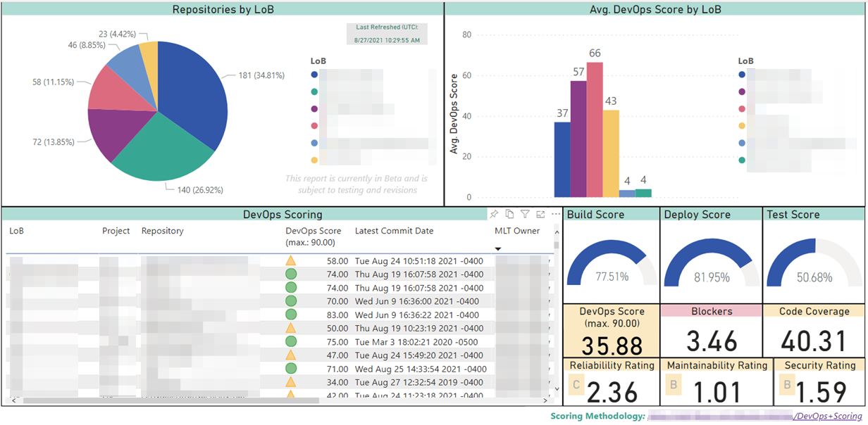
Got Score? – The Dashboard
Aggregated scores by LoB (not particularly actionable, but did promote some good-natured, healthy competition ☺
A breakdown of application counts by LoBs
The health of various CI/CD measures
Each line presenting a score for a single application, with the ability to click through and analyze all other report widgets update just for that application
Code Quality Measures

Slide 12
Got Score? – The (Continuous) Outcome
An actionable, quantifiable plan with easy-to-digest insights that can be tracked daily or in real time
A recognition of improvement initiatives, OR a course-correction when degradation is detected
As new capabilities are introduced in our Enterprise platform, refactor the methodology to highlight new adoption opportunity
Then, provide the revised, actionable “score” that is specific, measurable and attainable

Slide 13
Got Score? – What’s next?
Drive similar exercises to other company-wide initiatives (e.g. Agile maturity, Quality improvement, etc.)
Aggregate up to:
Team, to gauge efficiency
Product, to gauge delivery predictability and quality
Program/Portfolio, for organizational effectiveness
Enterprise, to demonstrate maturity
Qualitatively, so what?
How has moving from a score of XX to YY helped?
Is it helping us meet our customer needs?

Slide 14
Got Score? – What are we seeking?
What are your experiences and feedback about furthering your DevOps initiatives? (What?/Why?/How?/Who?/When?)
What levers have you effectively employed?
How have you tackled the burden of technical debt, especially surrounding code quality?
In regulated industries, how do you move the needle for processes and policies?
Especially those inherited from the pre-DevOps world?

